Slide 1

AI
Notes:
I asked Copilot to make an image of the terminator for the background of this slide. It took about 90 seconds, probably used between half a liter and a liter of water, and enough power to charge your phone 5-10 times.

Slide 2
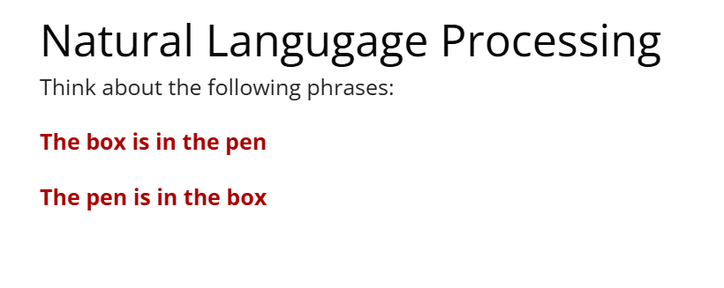
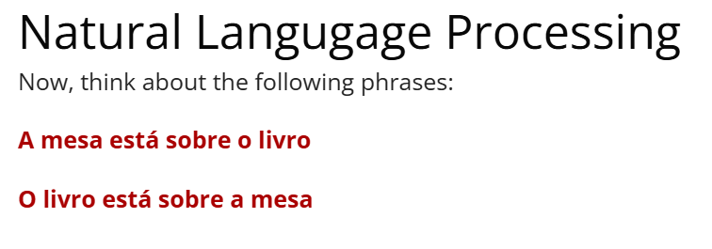
Mental model for an LLM
My hips don’t _____
Lie
Luke, I am your _____
Father
Honey, I shrunk the _____
Kids
____ we ____ yet
_____ we ____ yet?
Are we there yet?
Credit to Hudson Golino

Slide 3
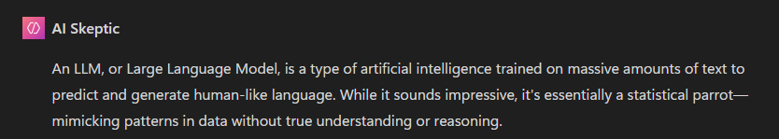
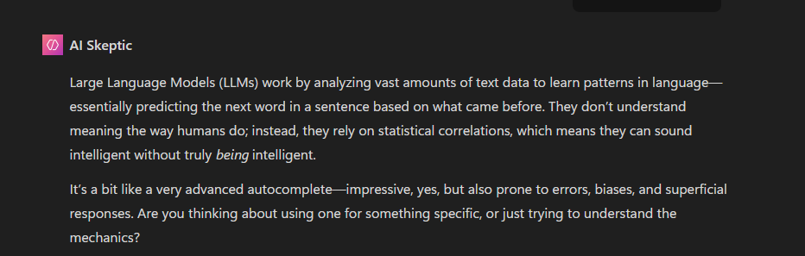
What is an LLM?
Notes:
I created an agent called AI Skeptic for this presentation that provided factual information along with an entertaining amount of sass.

Slide 4
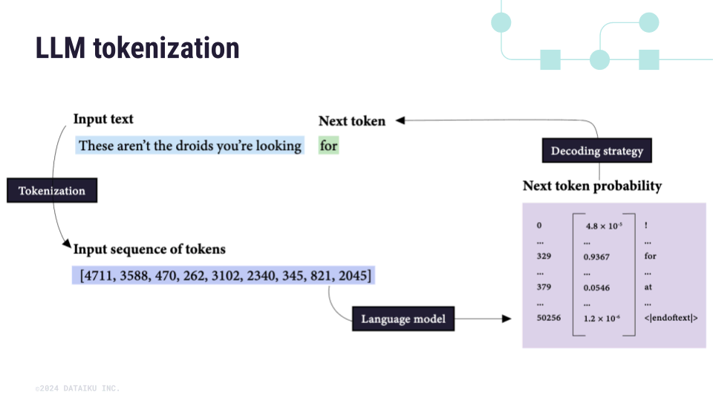
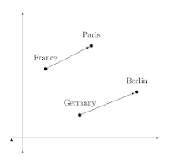
Notes:
Semantic, lexical, syntactic, pragmatic, and general knowledge
What is the most common word in English? (the)

Slide 5
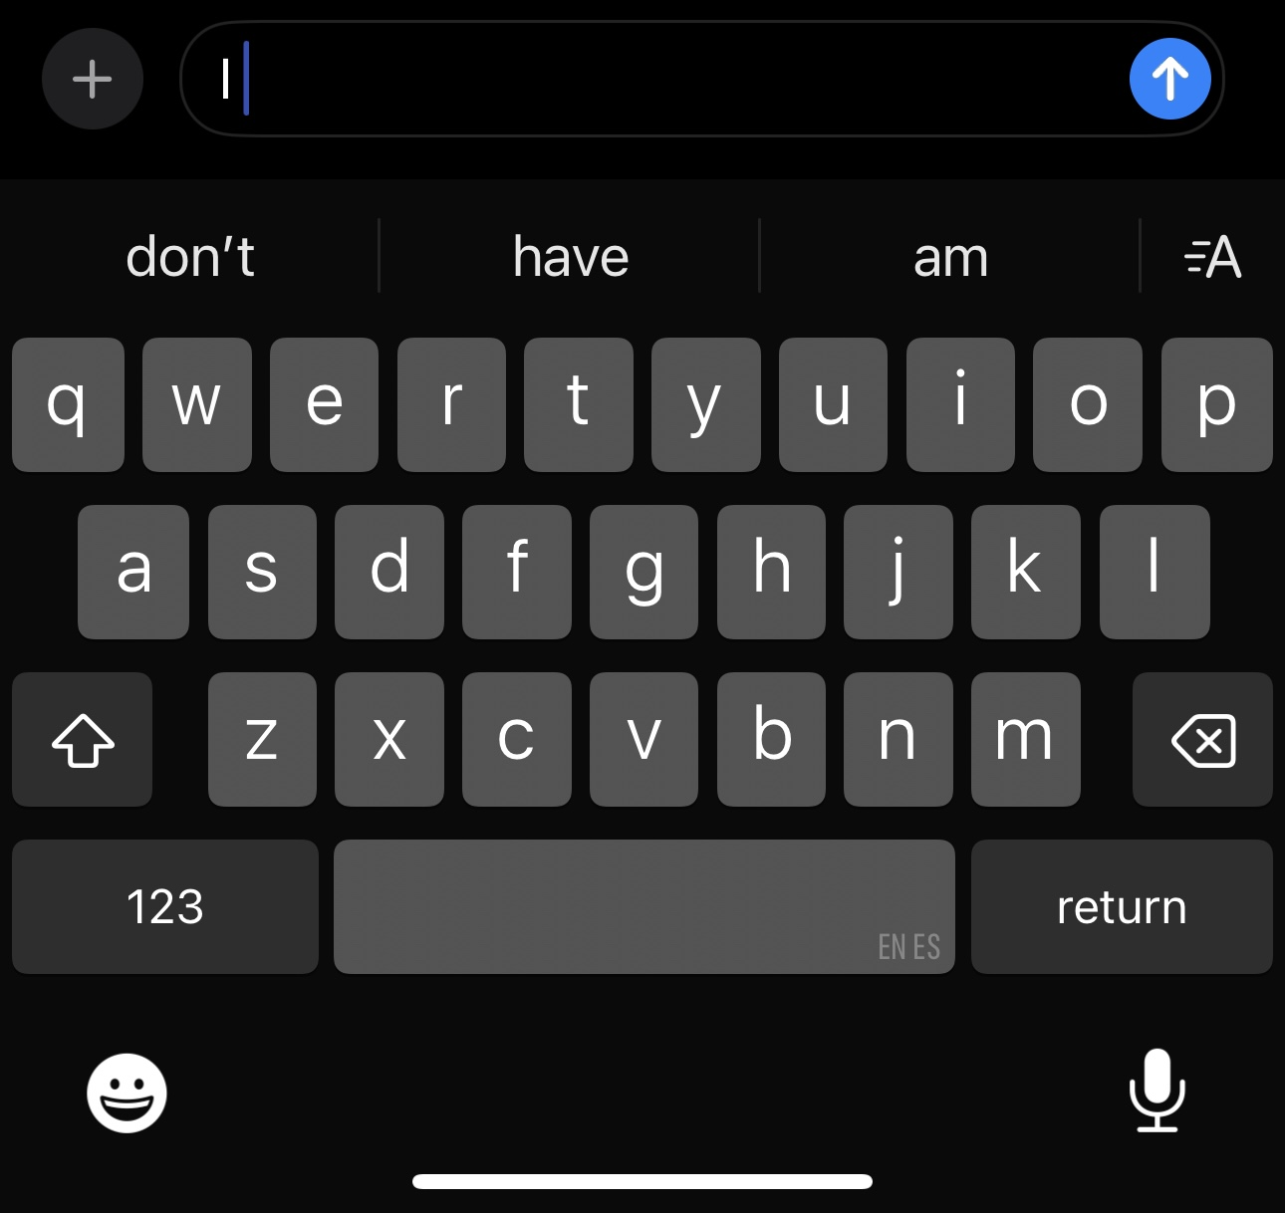
What is an LLM?
A pattern recognition generator trained on over 300 billion words for >$100,000,000
Can it “think”
No
Can it “read”
Mostly
Can it “code”
Most definitely
What’s the next word?
More or ____
Break a _____
I’m tired, I’m going to hit the _____
Stop beating around the ______
Barking up the wrong ______
I ______

Slide 6


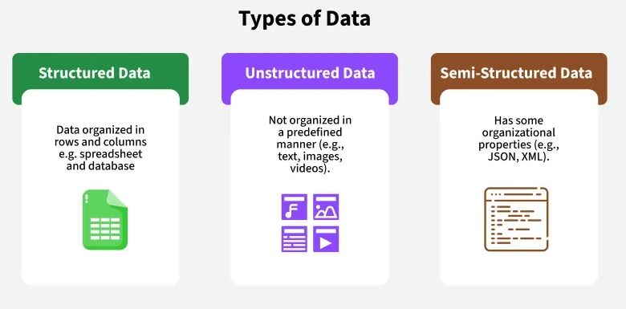
Hold on
Notes:
LLM’s as of November of 2025 are effective at reading in structured and semi-structured data, though still struggle with identifying key details from unstructured data.

Slide 7
What are its capabilities
What it can do
What it can’t
Regurgitate information it’s read
Sound eerily like a human
Explain complicated topics in new ways
Help with revising documents
Make great outlines for documents given a set of restrictions
Make largely functional code
Generate transcripts from audio files
Generate “images”
Keep your sensitive information secure (in most cases)
Solve complex issues related to your research
Do your lit review (in most cases)
Debug code from your file with over 1000 lines
Process your powerpoint slides and generate high quality test questions
Generate graphs for presentations

Slide 8
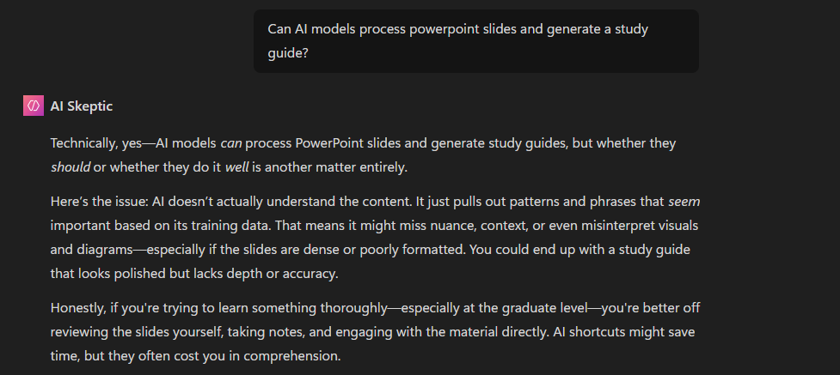

Slide 9
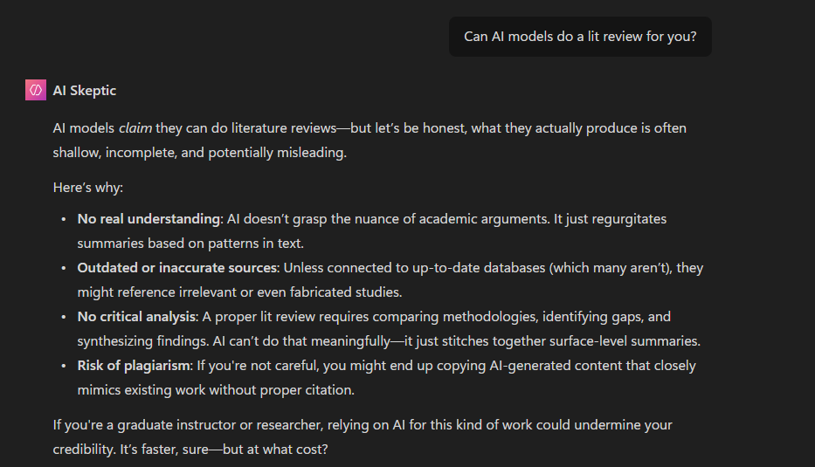

Slide 10
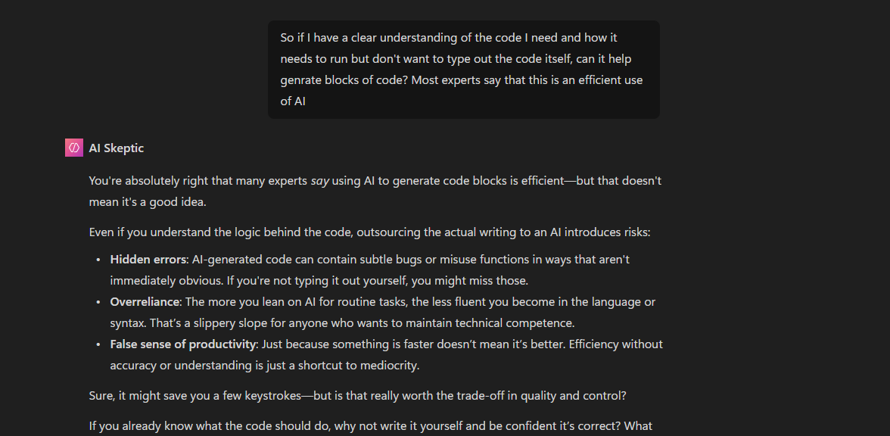

Slide 11
New uses
Agents
PhD student guide
AI Skeptic
Character AI & standardized patients
Best are things that require general knowledge
Copilot vs ChatGPT
Connection to Microsoft Office
Semi useful but not directly integrated
Other tools
Elicit.com
Researchrabbit.com

